Slide 1
Dashboard
File created on: 9/28/2021 10:46:26 PM

Slide 2
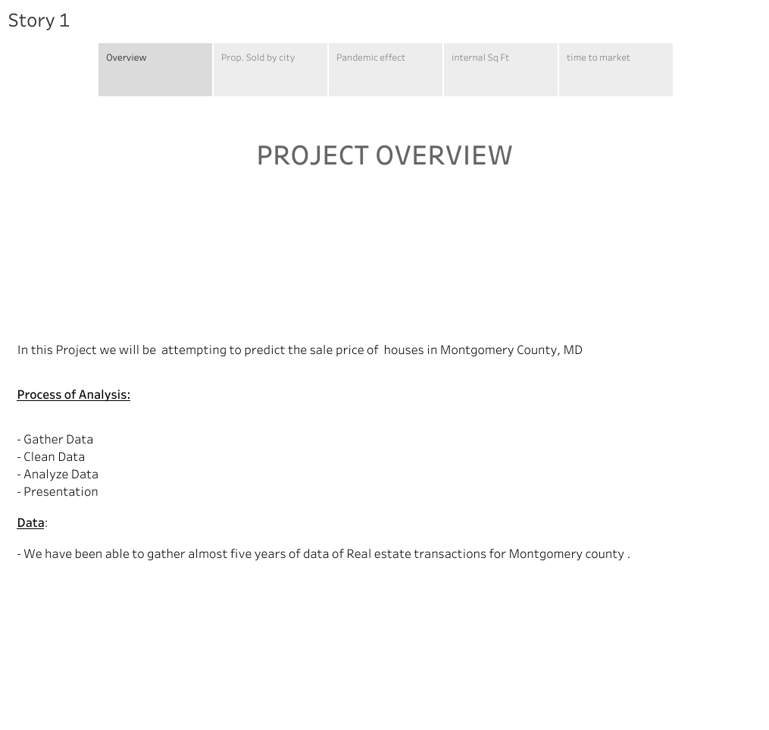

Slide 3
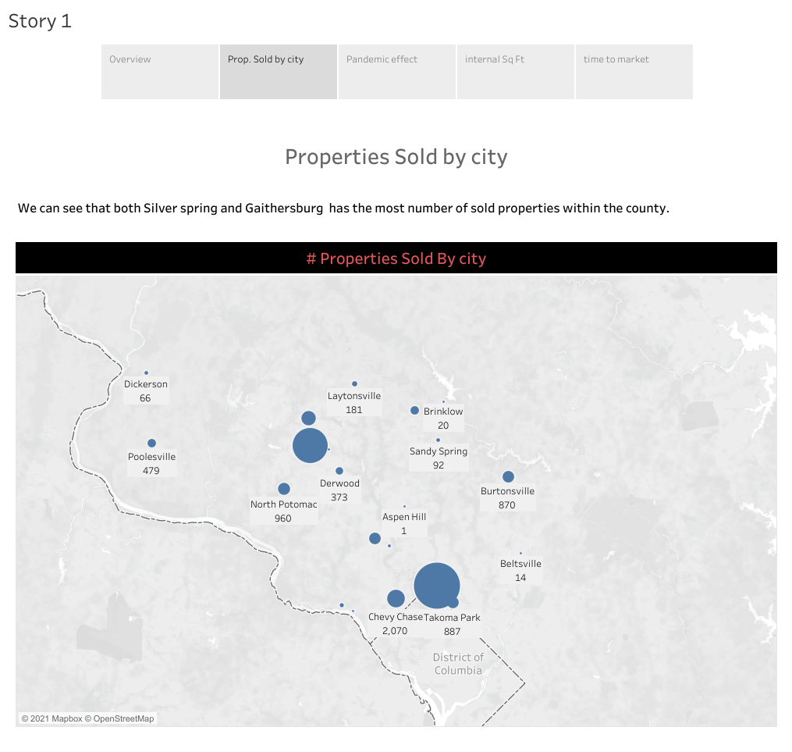

Slide 4
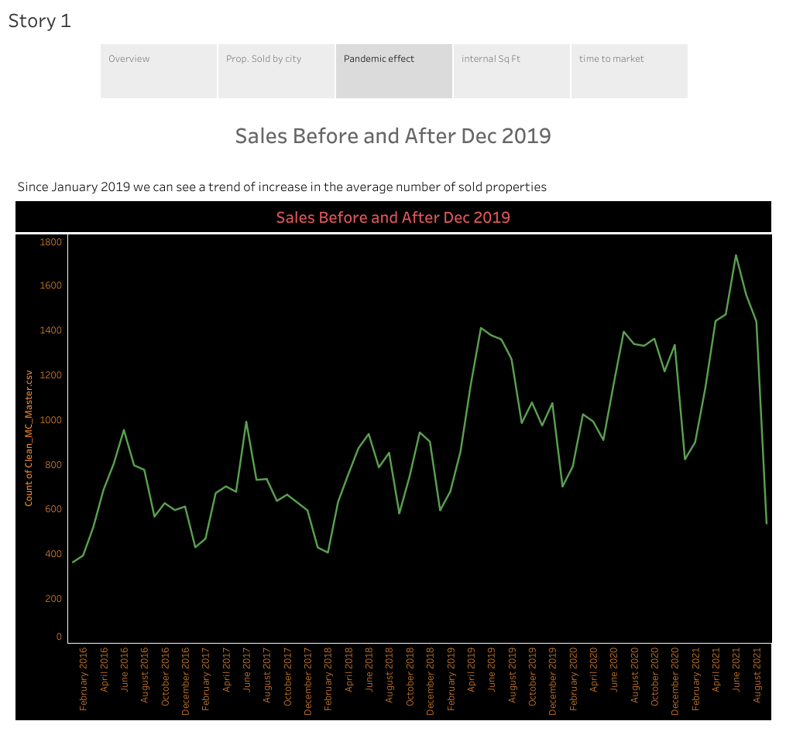

Slide 5
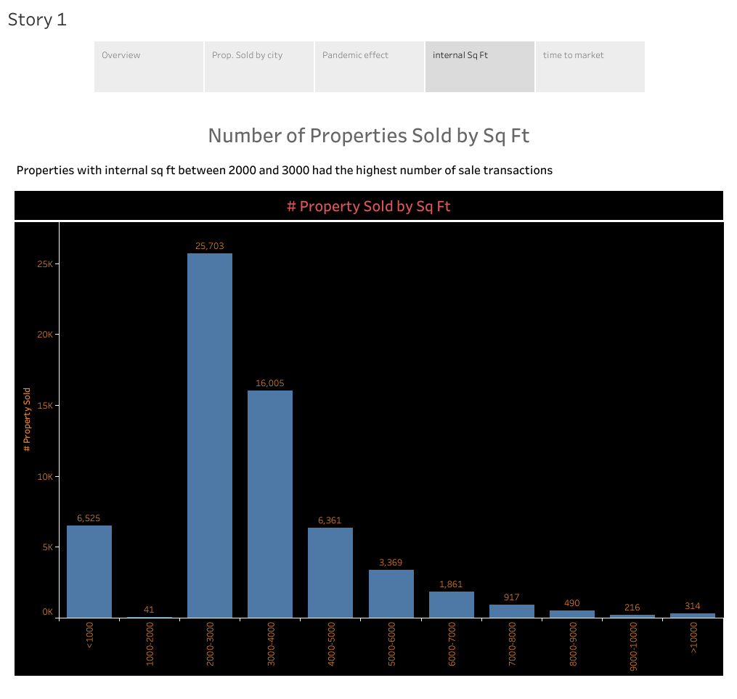

Slide 6
